Slide 1
Q-Measure-Learning for Continuous State RL Efficient Implementation and Convergence
Shengbo Wang
Daniel J. Epstein Department of Industrial and Systems Engineering, USC

Slide 2
Introduction

Slide 3
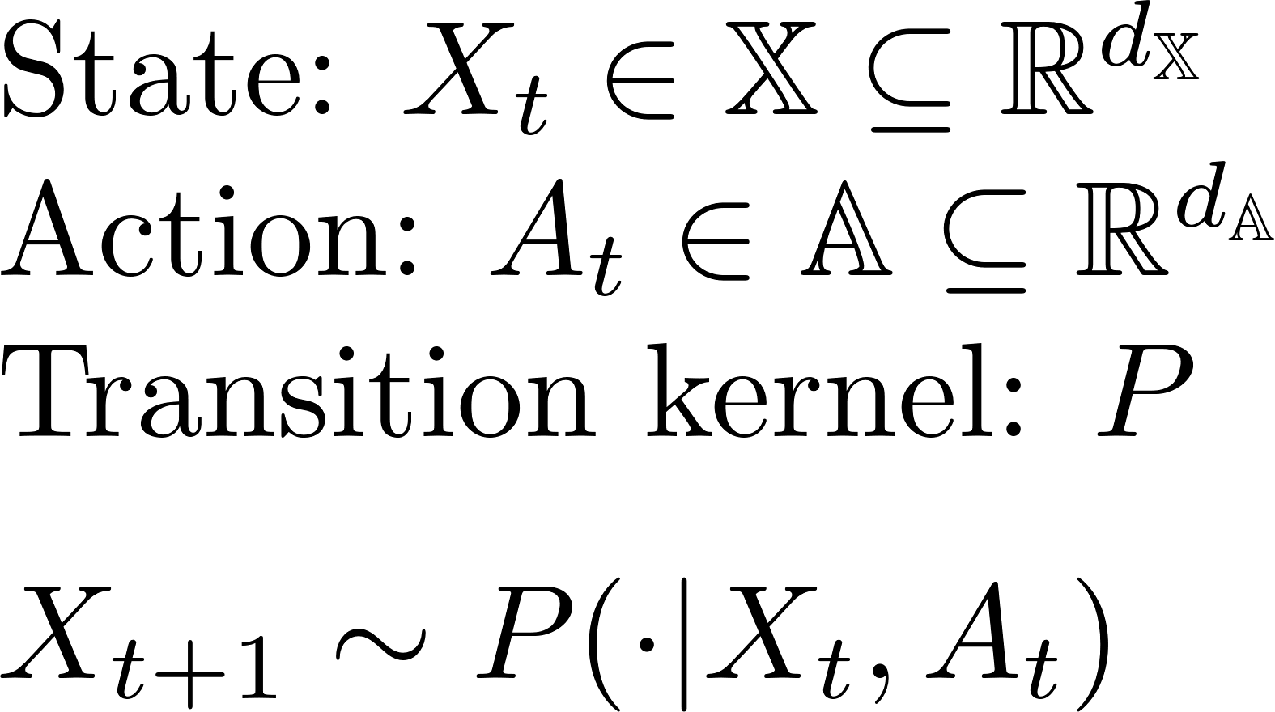
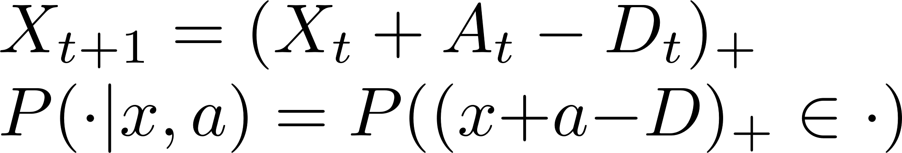

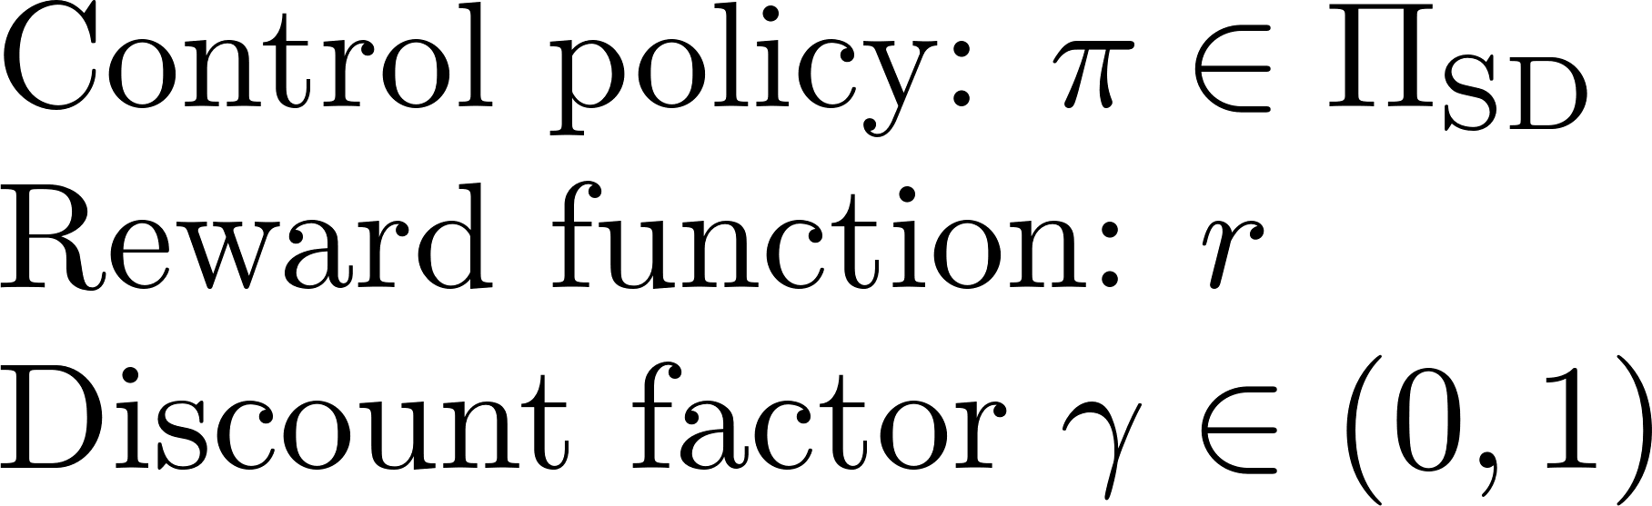
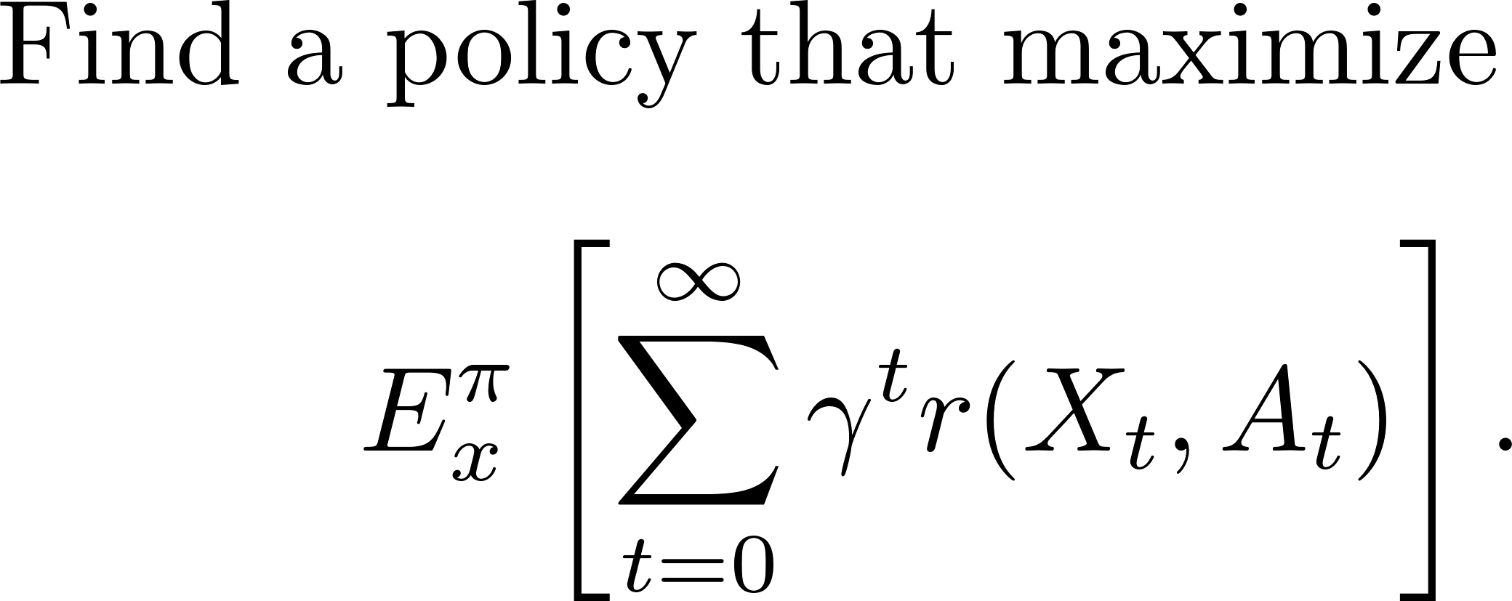
Markov Decision Processes

Slide 4
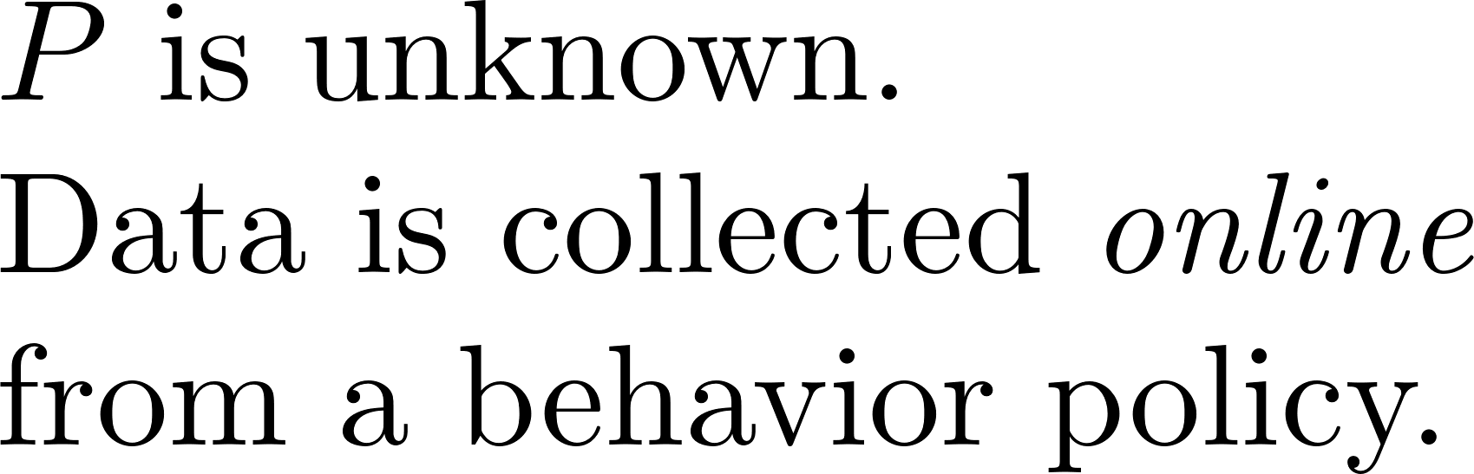
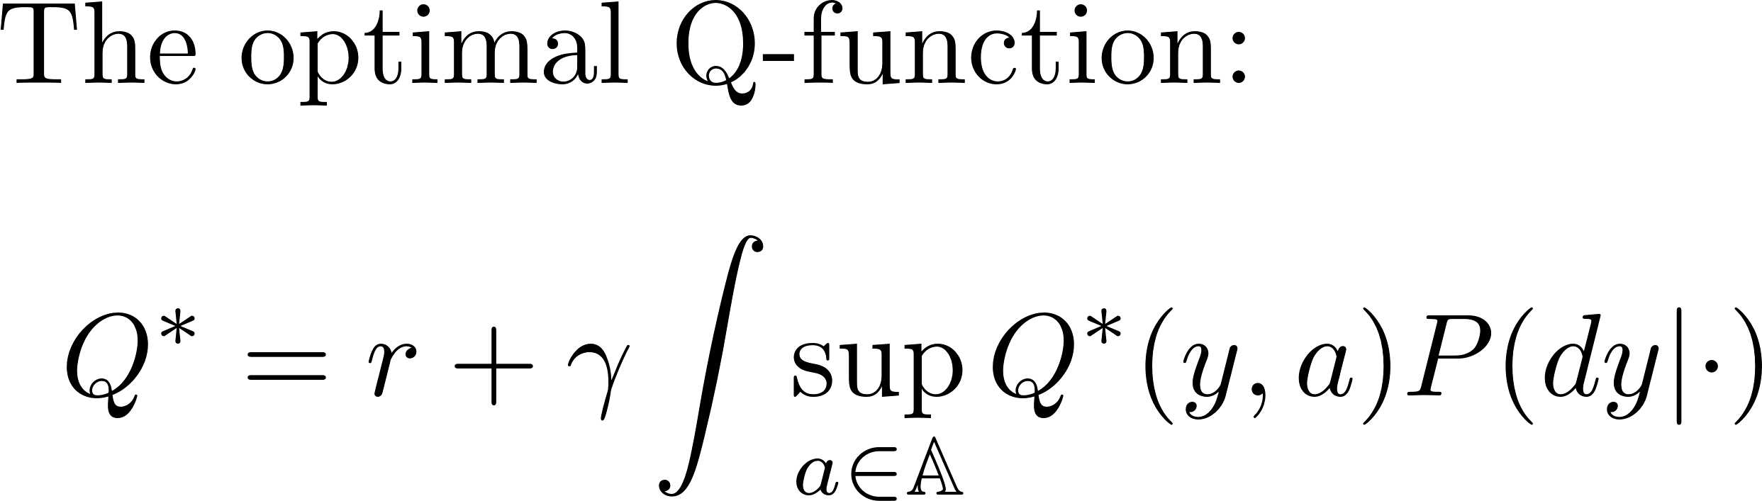
Reinforcement Learning

Slide 5
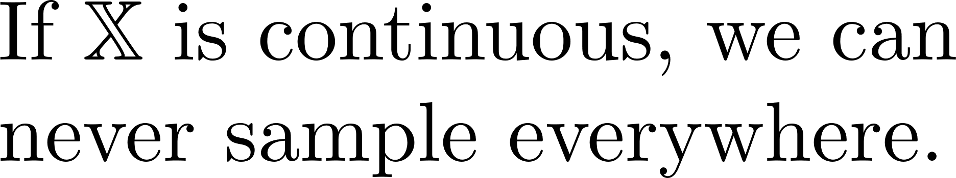
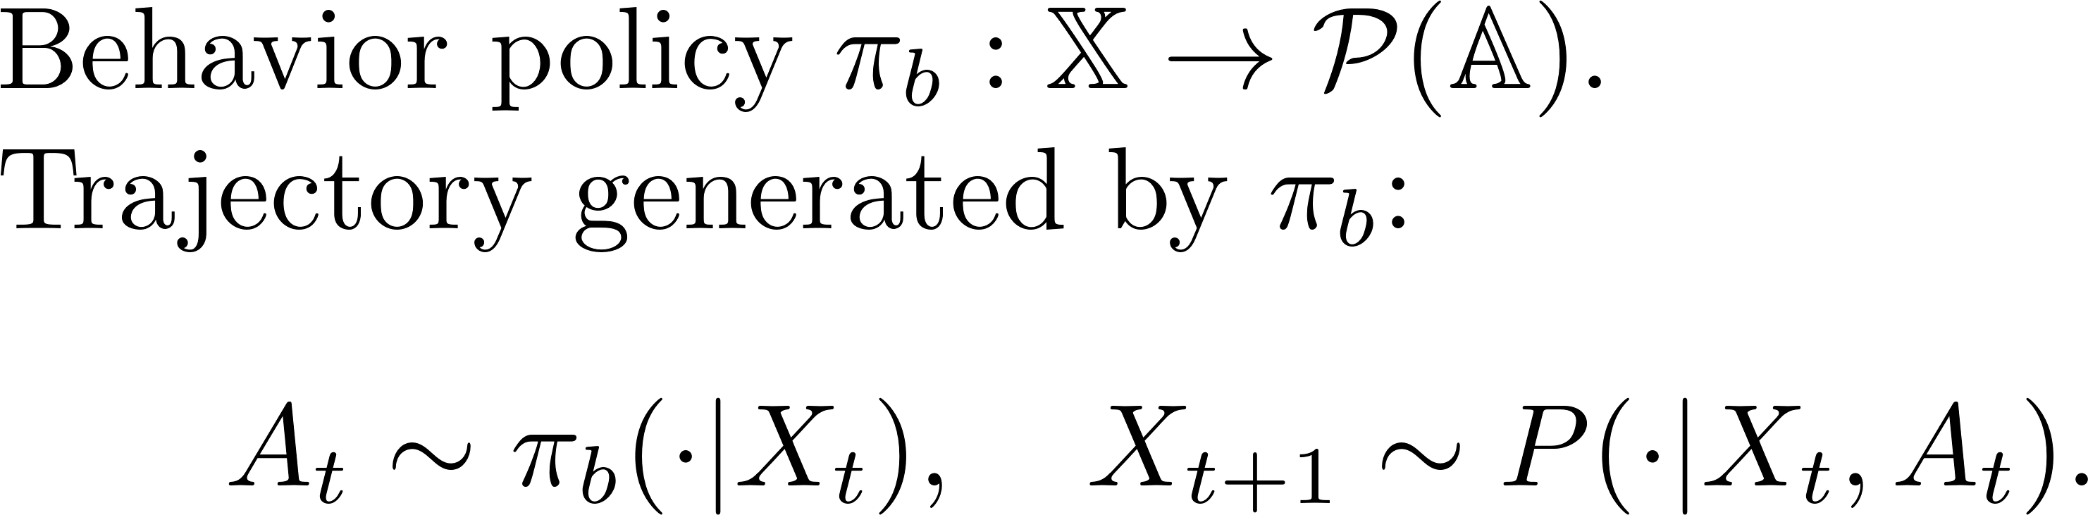

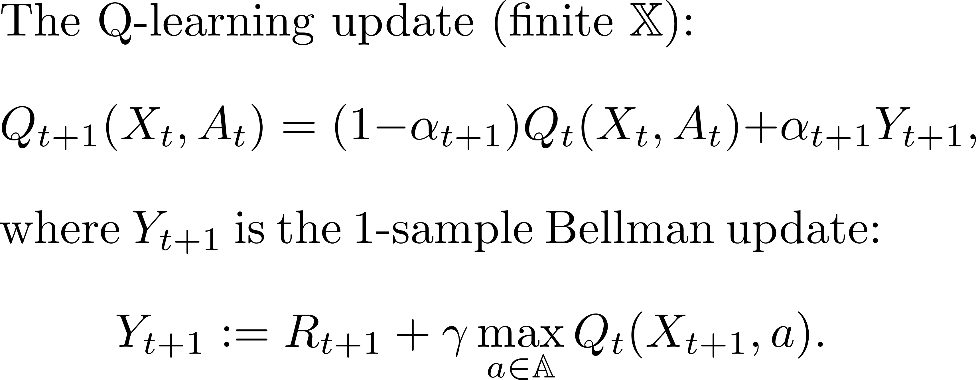
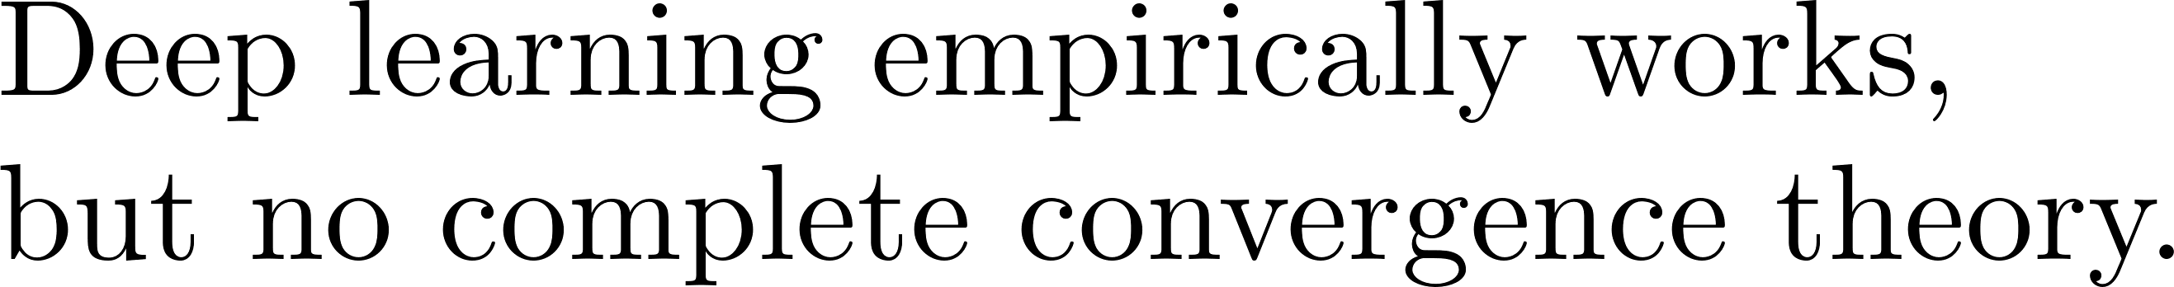
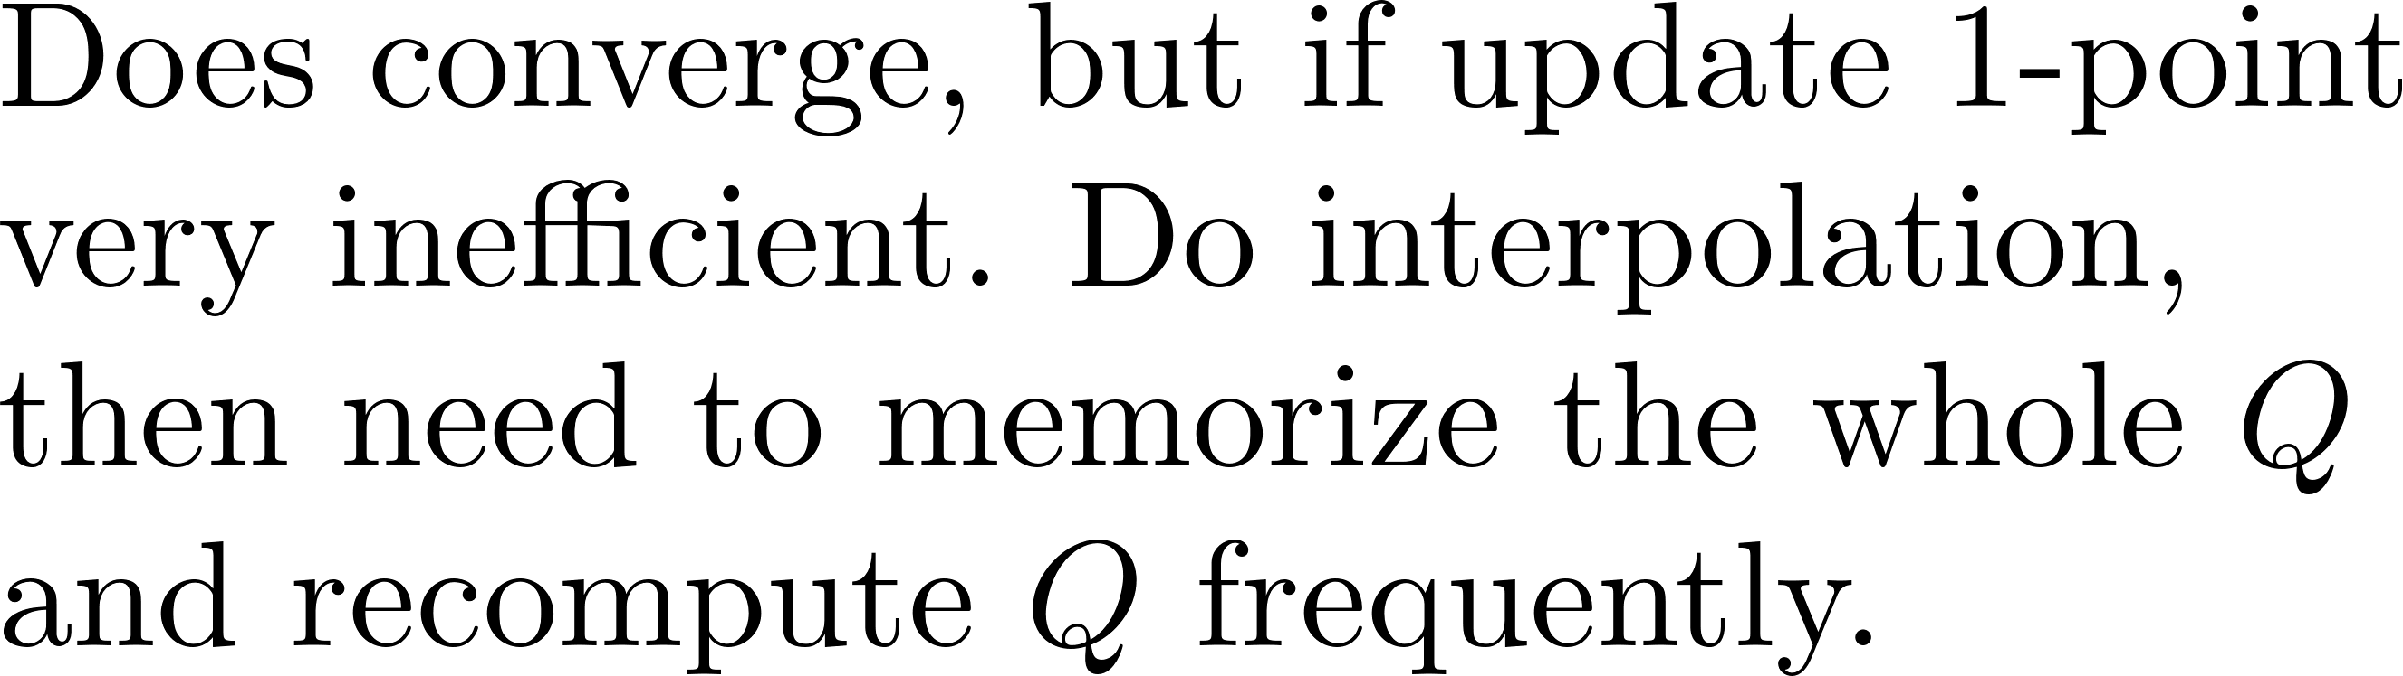
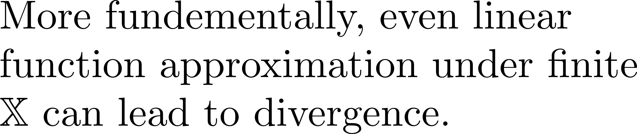
Q-Learning under a Behavior Policy

Slide 6
Q-Measure-Learning under a Behavior Policy
Efficient algorithm
for continuous states
Online single trajectory data under a behavior policy
Convergence theory
Main contributions of
this paper

Slide 7
Q-Function Based Approaches
Quantized / tabular methods: [Watkins and Dayan 1992], [Tsitsiklis 1994], [Jaakkola et al. 1993], [Borkar and Meyn 2000], [Wainwright 2019], [Li et al. 2024]
Function approximation methods: [Gordon 1995], [Tsitsiklis and Van Roy 1997], [Bradtke and Barto 1996], [Boyan 2002], [Lagoudakis et al. 2002], [Mnih et al. 2013, 2015], [Mou et al. 2022]
Kernel / empirical MDP methods: [Ormoneit and Sen 2002], [Ormoneit and Glynn 2002], [Jong and Stone 2006], [Taylor and Parr 2009], [Barreto et al. 2016]

Slide 8
Algorithm and convergence

Slide 9
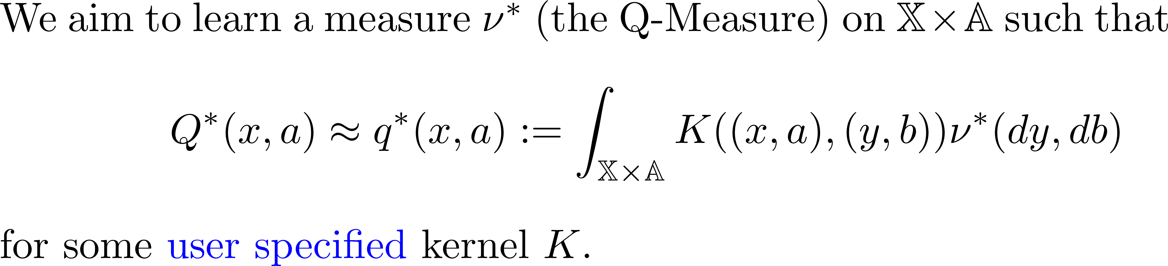
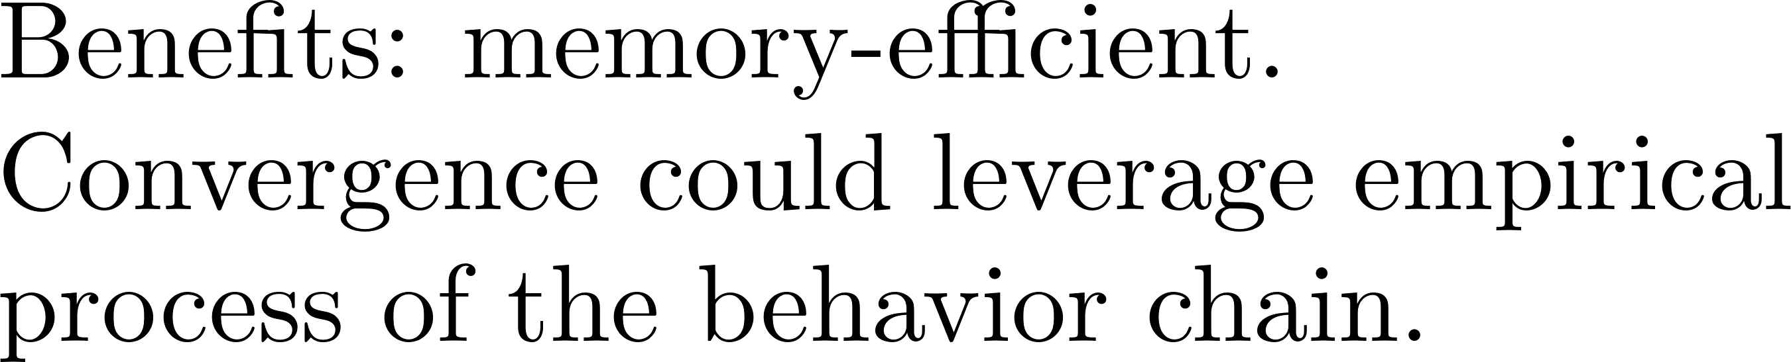
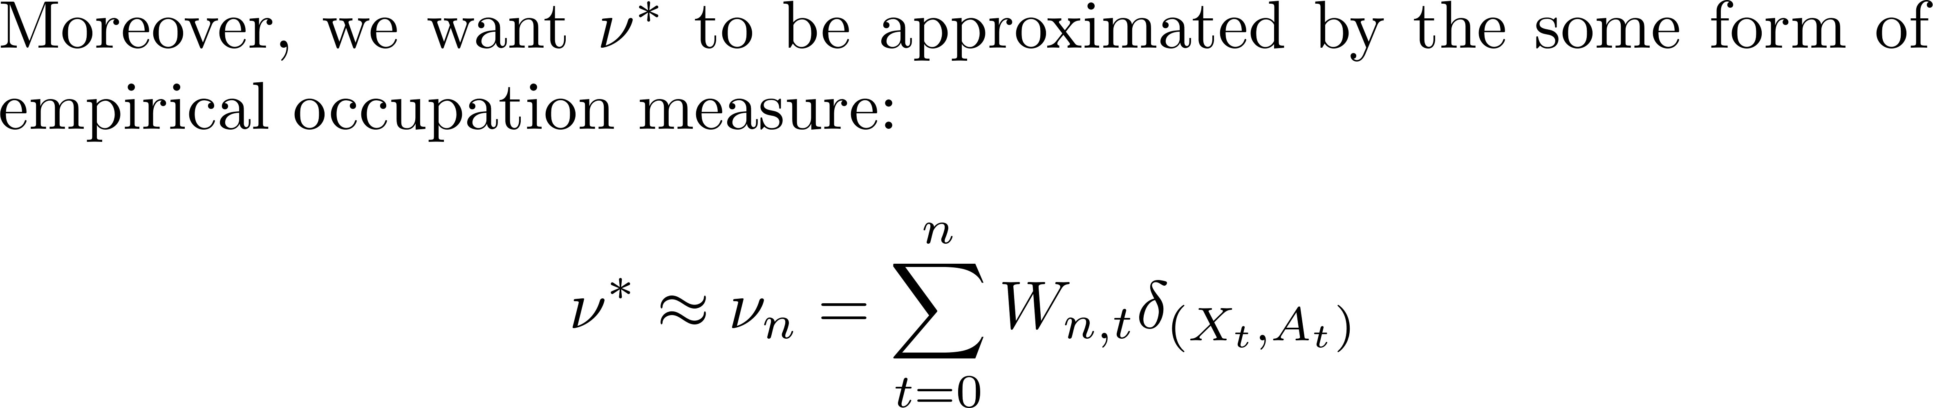
Core Idea: Learn a Measure, not a Function

Slide 10
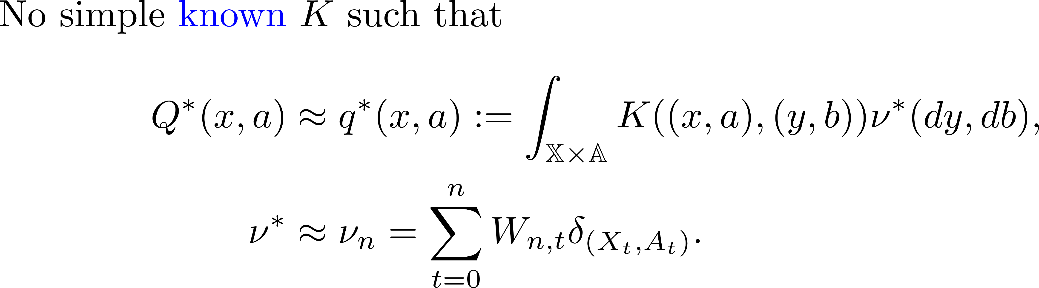
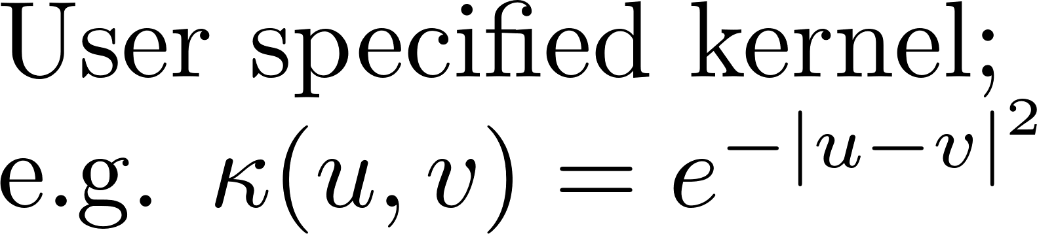
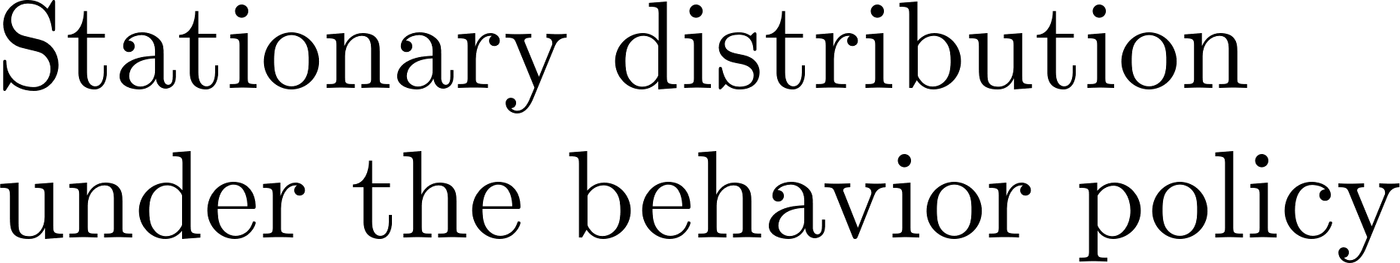
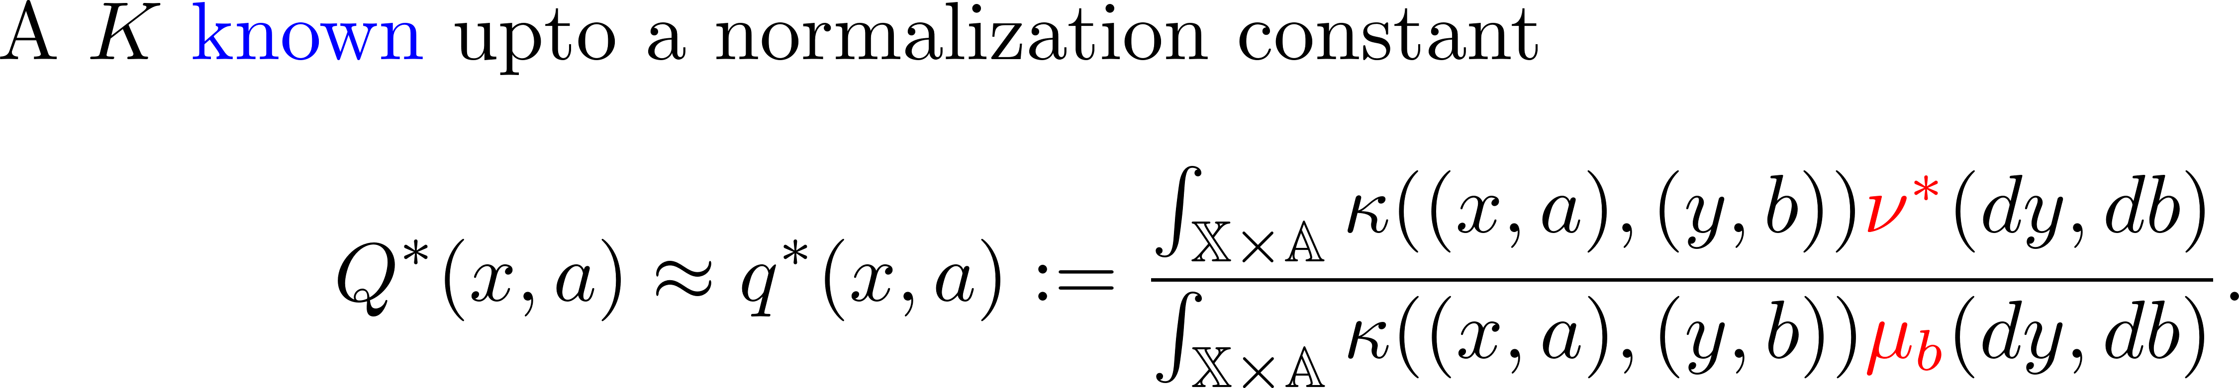
A Small Issue: No Simple K

Slide 11
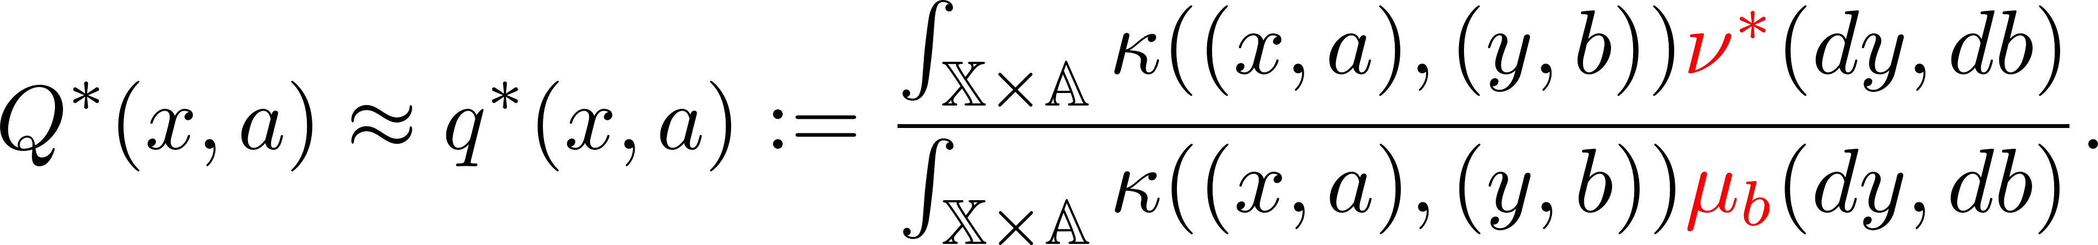
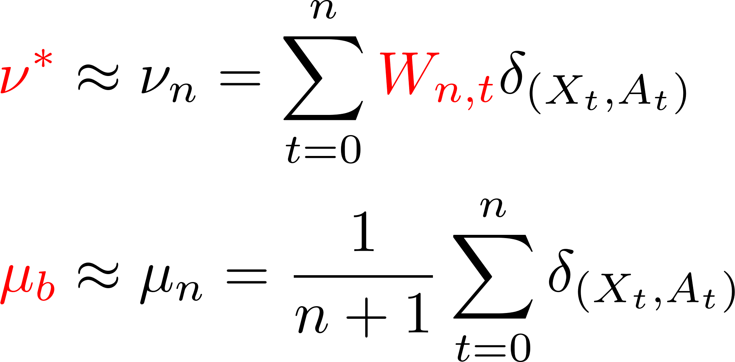
Learn the Unknown

Slide 12
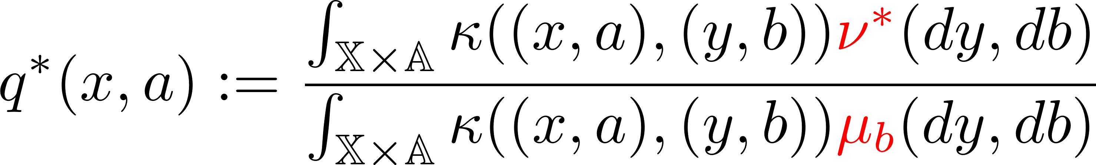
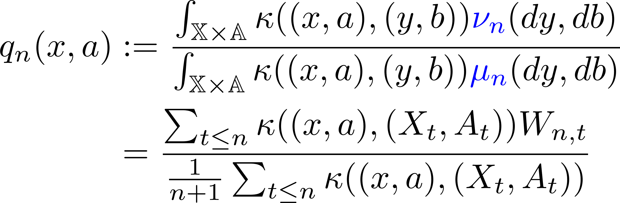
Update W using Q-Learning Update

Slide 13
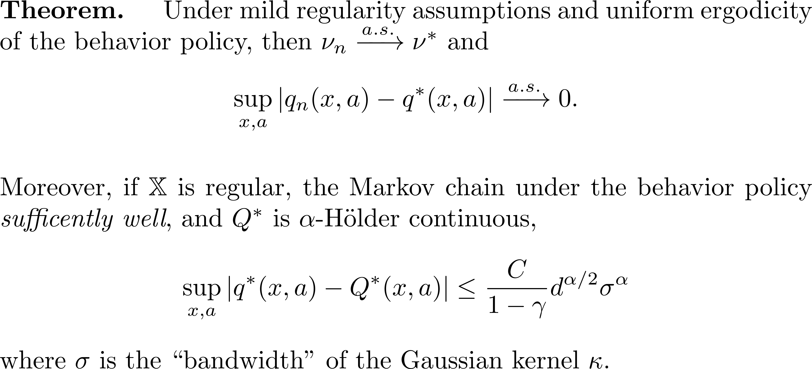
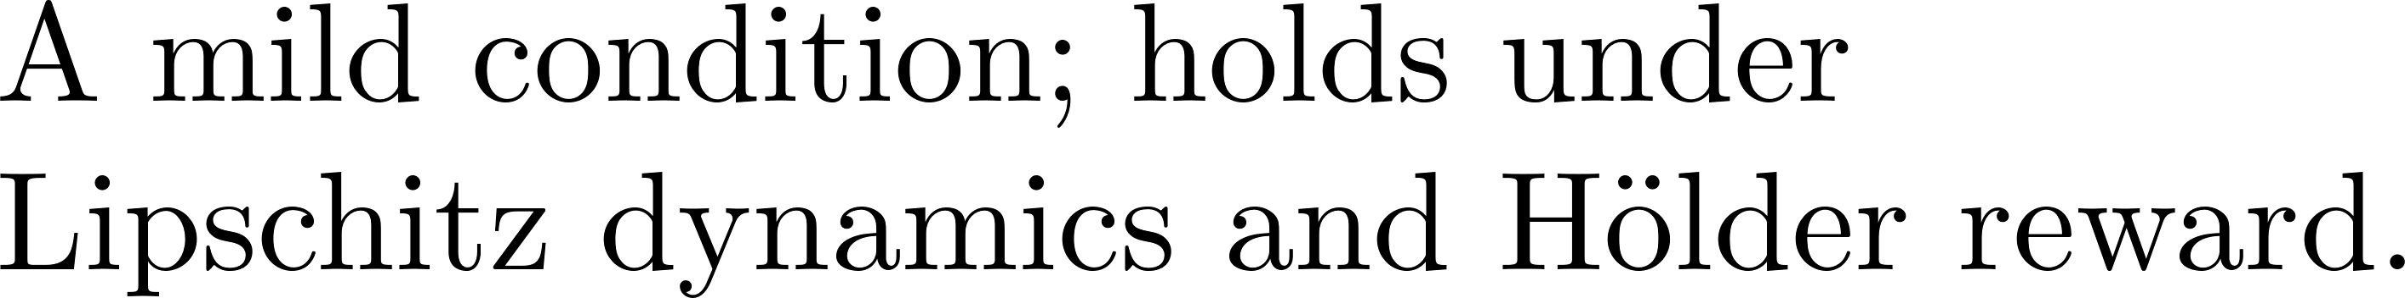
Convergence Theorem

Slide 14
Numerical experiment

Slide 15
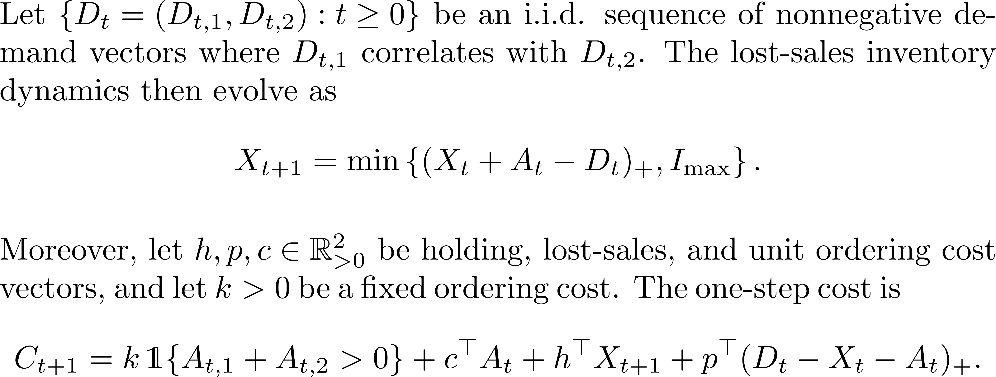
Setup: Two-Item Inventory Control

Slide 16
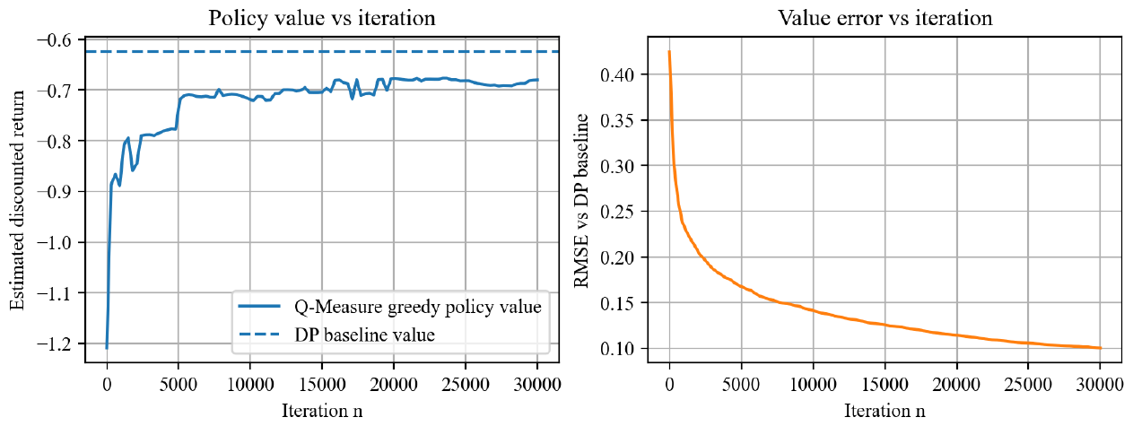
Convergence Curves
Greedy policy value improves quickly and then stabilizes.
RMSE against the DP benchmark decreases throughout training.
The remaining gap is expected: qₙ converges to q*, and q* differs from Q*.

Slide 17
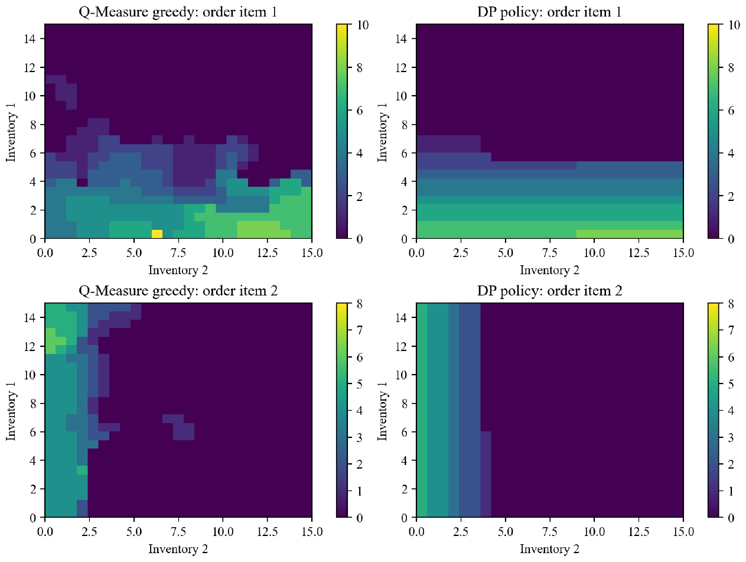
Policy Comparison

Slide 18
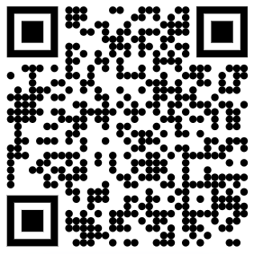
Thank You Your questions and thoughts are most welcome!

